Slide 1



Session: 2022-23 Major Project
Title: File upload system

Slide 2
Developer:-
Kartik Kathuria
191500384
B.Tech CSE
(Cloud Engineer – PAAS Developer)
(Azure Developer Associate – AZ204, AZ900 Certified)
Mentor:-
Mr. Kunwar Singh
Cloud Technical Lead
Reporting Manager:-
Mr. Kunwar Singh

Slide 3
Table of contents
Ideology behind hanu an insight company
Our mission
About the project
Project vision
Software and frameworks used
Hardware used
few glimpses from project insides
flow of project
references

Slide 4
Ideology behind Hanu software solutions
A Microsoft partner for over 15 years and an azure expert managed service provider exclusively dedicated to azure migration and integration, hanu supports enterprises with unequaled intelligence and expertise providing managed transformation, application modernization, and enterprise IT innovation.
Our Mission:- Hanu’s commitment is to deliver 100% scalability, transparency, and agility to guide, set, and keep organizations on a clear path to the cloud and to their transformation.

Slide 5
About the project
This project helps us to upload any type of file on azure blob storage and store its path in the database server for direct access.
Features of file upload system:-
Attached with SQL server Management for Database connection
Connected with Azure blob Storage to upload files on the cloud.
Files can also be deleted from both Database and Azure storage.
File size parameter also added.
Can view files directly.
Duplicate files are not allowed.

Slide 6
Project vision
Making project flow smooth by connecting it with the Azure cloud.
Get to know more about asp.net MVC and its benefits in the trending market.
To make the user experience smooth.
Project architecture in a more organized way.
Get to know more about relational databases like SQL.

Slide 7
Software and frameworks used
Azure portal:- connection with azure blob storage
Microsoft visual studio:- for writing code
SQL server management studio:- connection with the database
GitHub:- for maintaining repository
Asp.net:- dot Net framework used
Complete code is written in c# language.
Project based on asp.net MVC core.

Slide 8
Hardware used
Processor used: intel i5
Operating system: windows 10 and windows 11
Ram: 4gb (minimum required)
Hardware devices: laptop
Hard disk: 256 gb

Slide 9
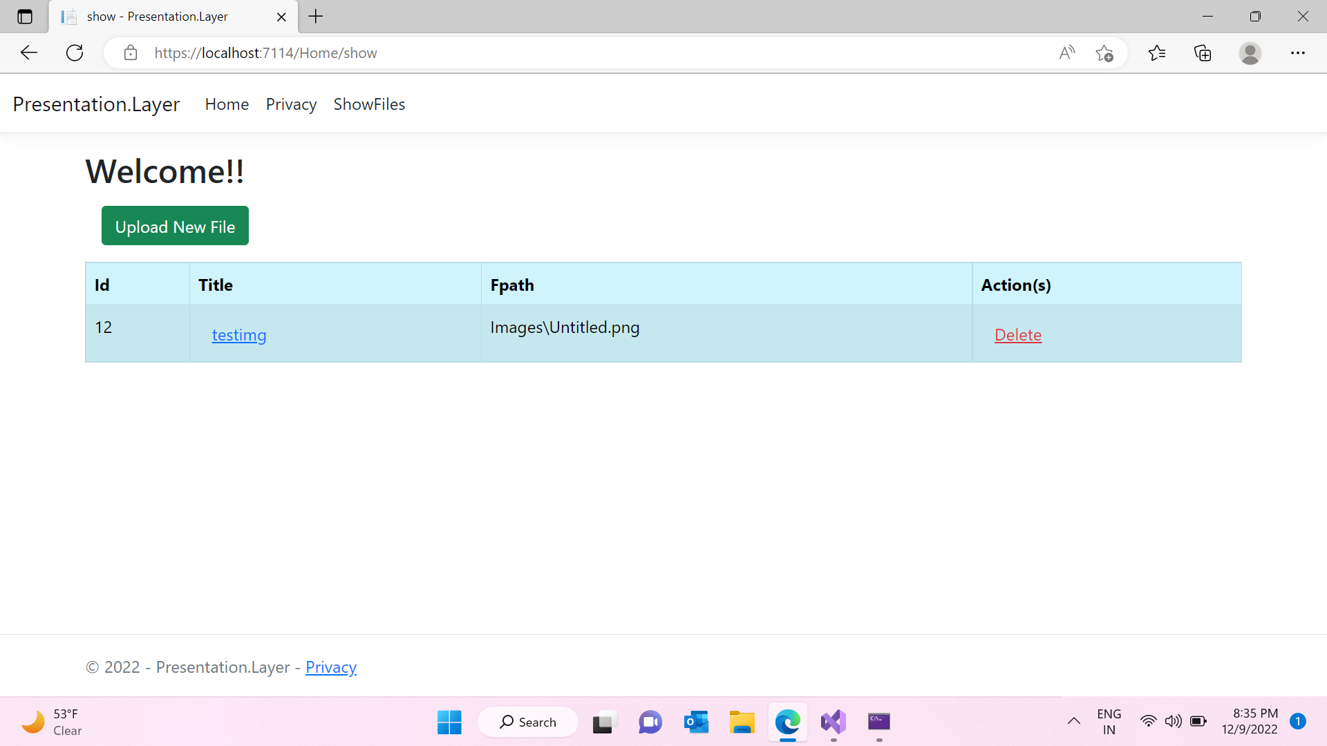
Few glimpse
Front page:

Slide 10
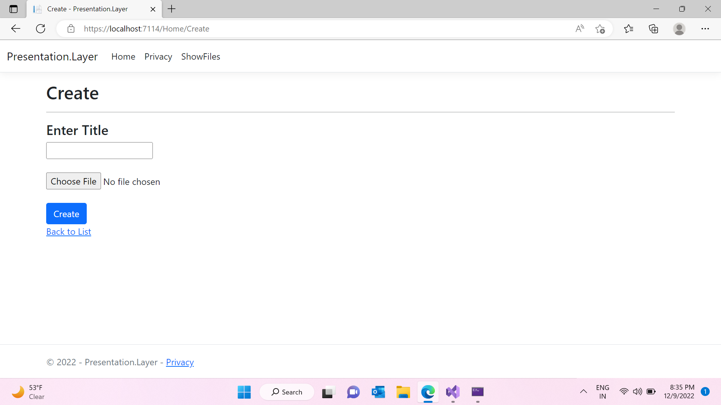
Few glimpse
Upload files:

Slide 11
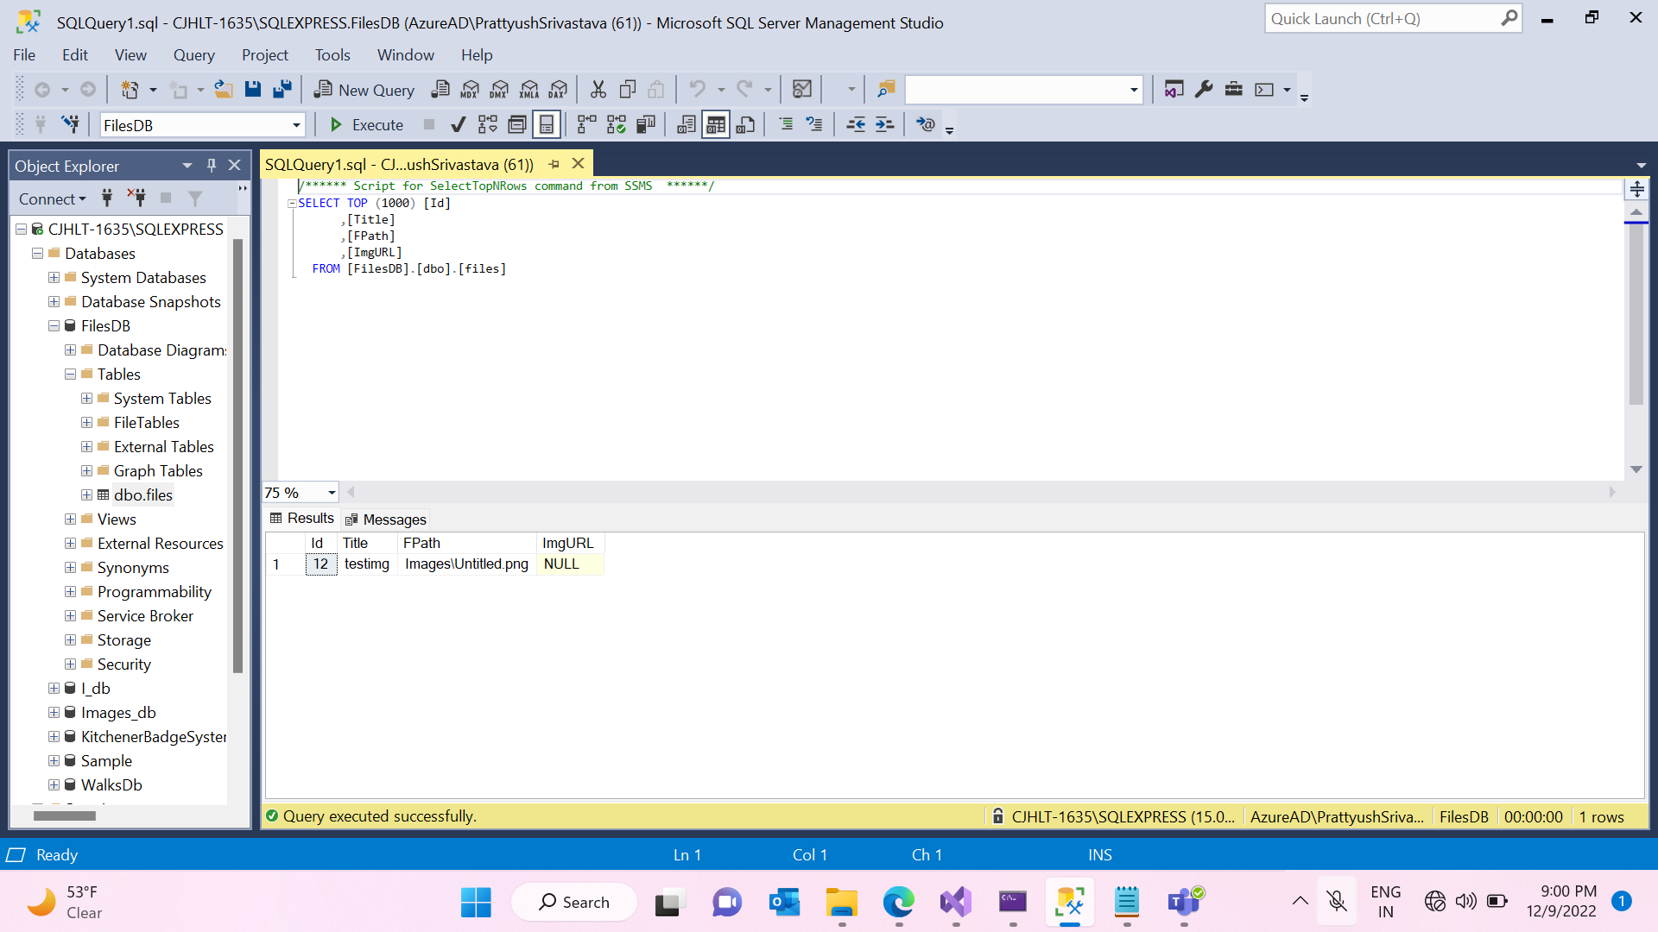
Few glimpse
Sql server:

Slide 12
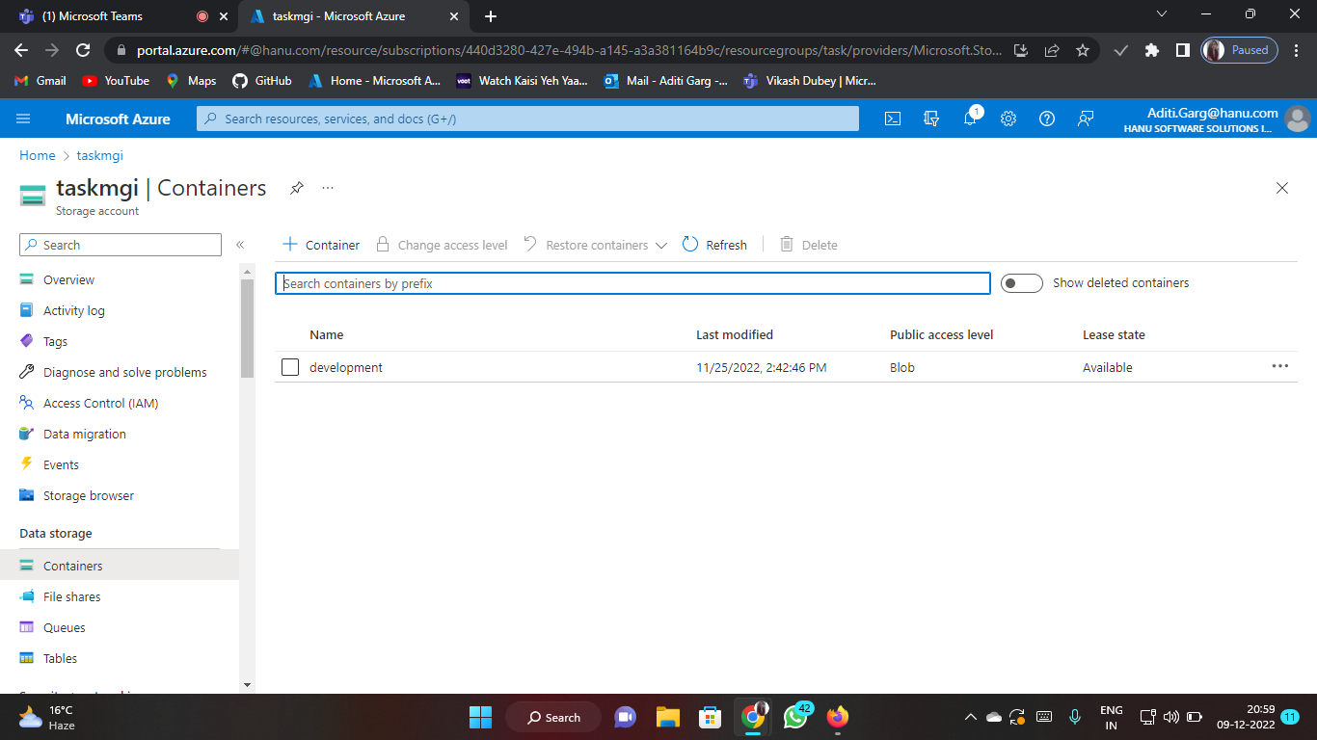
Few glimpse
Azure portal:

Slide 13
Flow of project
Firstly user will access the required URL.
Then they will be directed to the welcome page.
From there they can upload a new file or can view the items already uploaded and can also preview any file just by clicking on its name.
After accessing the upload new file page they can upload files of any type unless it is more than 5 MB and has already been uploaded.
User can also delete files directly from the welcome page which will directly remove files from both cloud storage and the database.

Slide 14
References
Microsoft documentation: https://learn.Microsoft.Com/en-in/
Geeks for geeks: https://www.Geeksforgeeks.Org/introduction-to-asp-net/
Udemy
Youtube
Azure portal: Https://portal.Azure.Com/#home

Slide 15
Thank you

